Slide 1
REPRESENTATIONS
To address the problem of generating audio clips consisting of 16384 samples, at a sample rate of 16 kHz.
Representations which helps to retain phase information.
A fixed transformation is applied to all input audio data, and its inverse is applied to the generator output to produce audio signals.
Short-time Fourier Transform (STFT)
Short-time Discrete Cosine Transform (STDCT)
Data Scaling And Normalization
The magnitudes of the DFT and DCT outputs are scaled logarithmically both to simulate human auditory perception and to better bound the range of values
Further, the magnitudes of the data are rescaled on a per-frequency basis

Slide 2
Short-time Fourier Transform (STFT)
Taking Fourier transformation for short time frames of the audio signal
Hann windows of length 256 with a stride of 128 samples
Zero-pad the boundaries: For complete reconstruction
This yields 256 complex values for each of the 129 windows
Real signal -> Hermitian symmetry -> discard upper 127 frequencies
Time and frequency dimensions as a 2D spatial grid: a single-channel complex-valued image of shape (129, 129, 1)
Separate the real and imaginary components into individual channels: an equivalent real image of shape (129, 129, 2)
Final image has shape (128, 128, 2)
Nyquist Frequency discarded -> 128 Frequencies
To preserve equal spatial dimensions, number of time windows were reduced to 128

Slide 3
Short-time Discrete Cosine Transform (STDCT)
Type-II DCT –
computes the DFT of a signal’s even extension.
Hann windows of length 256 with a stride of 64 samples –
still maintains the constant overlap-add property.
Discard the zero-padded windows at the end to yield a real image of shape (256, 256, 1)

Slide 4

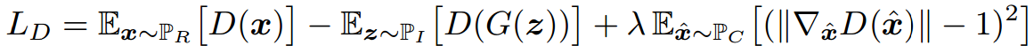
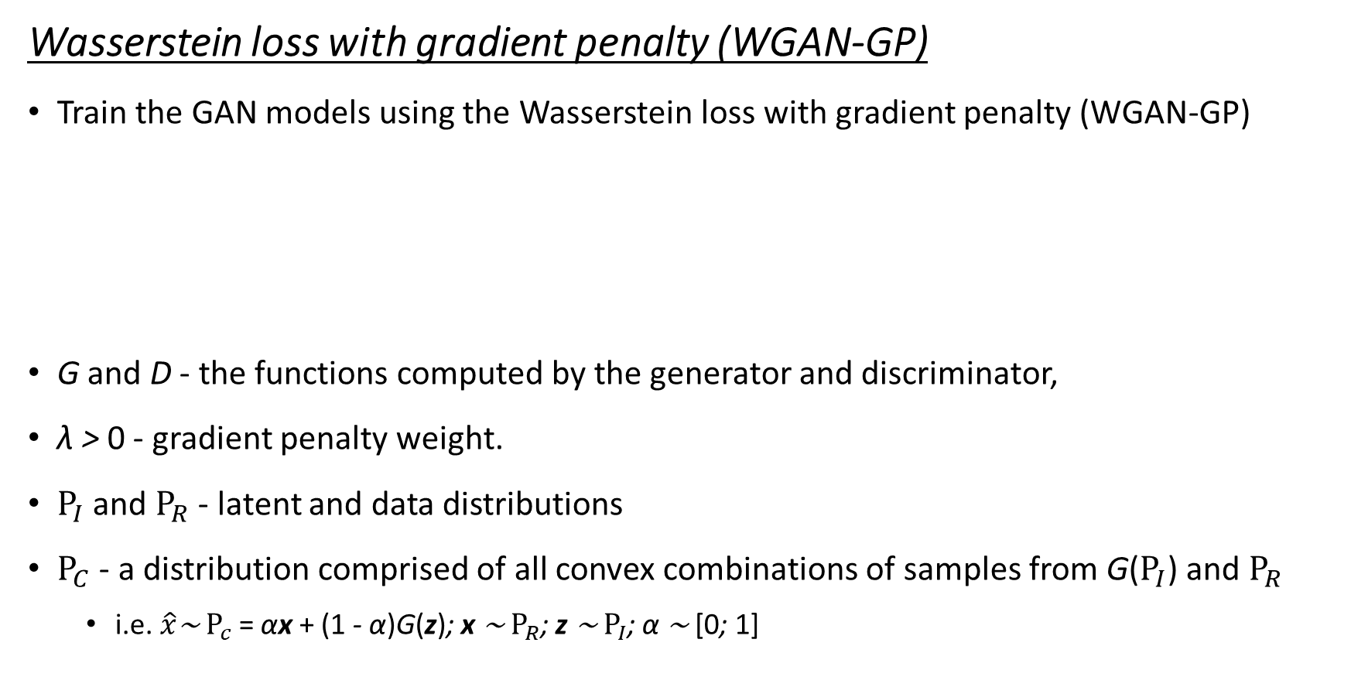
ARCHITECTURES
Wasserstein loss with gradient penalty (WGAN-GP)
Train the GAN models using the Wasserstein loss with gradient penalty (WGAN-GP)
G and D - the functions computed by the generator and discriminator,
λ > 0 - gradient penalty weight.
$Ρ_{I}$ and $Ρ_{R}$ - latent and data distributions
$Ρ_{C}$ - a distribution comprised of all convex combinations of samples from G($Ρ_{I}$) and $Ρ_{R}$
i.e. $\hat{x}$∼ $Ρ_{c}$ = αx + (1 - α)G(z); x ∼ $Ρ_{R}$; z ∼ $Ρ_{I}$; α ∼ [0; 1]

Slide 5
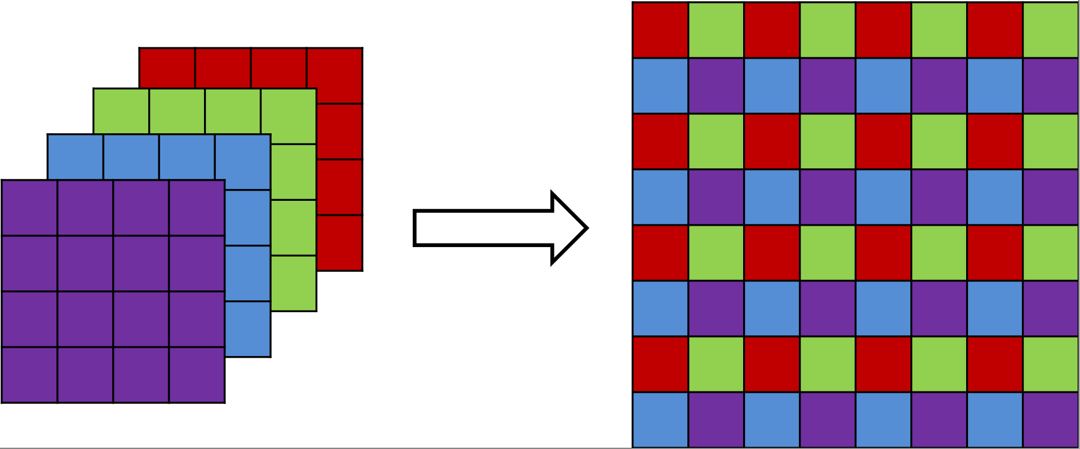
Sub-Pixel Convolution
Alternative to transpose convolutions
As transpose convolutions are prone to producing “checkerboard” artifacts
Regular convolutions followed by “sub-pixel shuffling”

Slide 6
TRAINED GAN MODELS
DFT GAN
Generator output and Discriminator input to have 2 channels
Kernel weights are initialized using He uniform initialization for operations directly preceding ReLU or leaky ReLU, and Glorot uniform initialization for all other operations.
All layers also have biases, which are zero-initialized.
DCT GAN
Transposed convolution layer at the end of the Generator architecture
Transposed convolution layer at the beginning of the Discriminator architecture
This allows the generator’s output and discriminator’s input to have the correct dimensions for our DCT representation
Weights and biases are initialized as in DFT GAN

Slide 7
TRAINED GAN MODELS (ctd)
DFT-SP GAN and DCT-SP GAN
Copy the architectures for the DFT and DCT GANs and replace the 5×5 stride-2 transpose convolutions of the generators with 3×3 sub-pixel convolutions.
The choice of 3 × 3 filter sizes allow the sub-pixel convolutions to maintain the same effective receptive field as the replaced transpose convolutions.

